Slide 1



15th European Academy of Occupational Health Psychology Conference «Supporting knowledge comparison to promote good practice in occupational health psychology»
The cost-effectiveness of H-work multilevel interventions to promote mental health in SMEs and public workplaces
Emmanuel Aboagye¹, Karina Nielsen², Marco De Angelis³
¹Institute of Environmental Medicine, Karolinska Institutet, Sweden
²Management School, University of Sheffield, UK
³Department of Psychology, Alma Mater Studiorum – University of Bologna, Italy

Slide 2
Mental health in SMEs and public organizations
Most work-related health problems are described as stress, anxiety, depression, exhaustion
Mental health issues are strongly correlated with increased sickness absence, increased presenteeism (i.e., working with reduced capacity), productivity loss, turnover
Most organizations are unsure how to deal with mental health issues of their employees and how to link it to organizational performance, particularly in resource-constrained SMEs.

Slide 3
SMEs and public organizations
SMEs - enterprises with fewer than 250 persons employed
  Almost all EU enterprises (99.8%) are SMEs
  SMEs provide 65% of EU employment, 53% of EU GDP
  SMEs struggle with OSH implementation compared to than large, private enterprises.
Public organizations
  accent on activity to represent commitment to OSH but do the bear minimum to protect workers

Slide 4
Objective
  H-work will evaluate multilevel interventions aimed at promoting mental health in SMEs and public organizations and conduct a cost-effectiveness on the implemented interventions.

Slide 5

General methods to help businesses in financial analysis
Most businesses are familiar with the ROI to help determine whether to invest in interventions
This presents a business case/perspective for the intervention costs and benefits both measured in monetary terms.
NB (Net benefit), BCR (Benefit-cost ratio), and the ROI (Return-on-investment)

Slide 6
Direct and indirect costs of interventions
Intervention costs can be divided into direct and indirect costs.
  direct costs - cost resulting from implementing the workplace intervention.
  For e.g., costs of materials and equipment, cost of personnel or facilitators, etc.
  indirect costs - during an intervention, employees use part of their working hours to participate, attend courses and skill training, attend meetings and more.
  For e.g., travel cost to get to a meeting, time spent in meetings, time spent to perform administrative tasks in connection with the intervention.

Slide 7
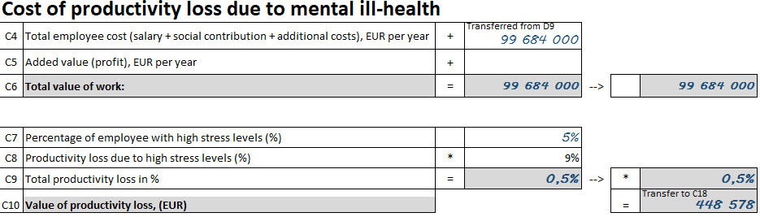
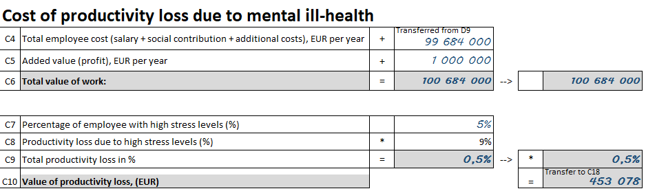
Benefits through productivity metrics
The most common productivity metrics employers use is the revenue per employee and output per hour worked.

Slide 8
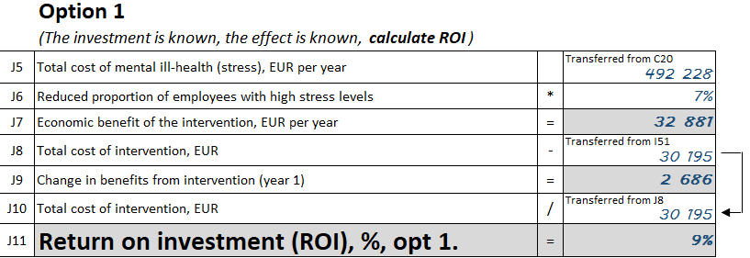
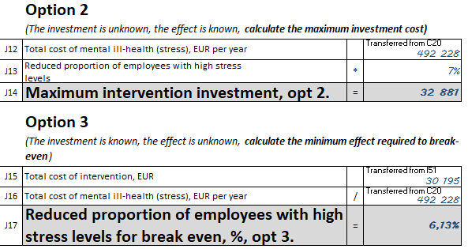
Financial decision making - ROI
The decision makers could be employers, organization management, economists, managers, HR, work environment group, safety/protection committee, occupational health services providers.
Two-thirds of organizations would consider investing in interventions that had a rate of at least 8%.

Slide 9
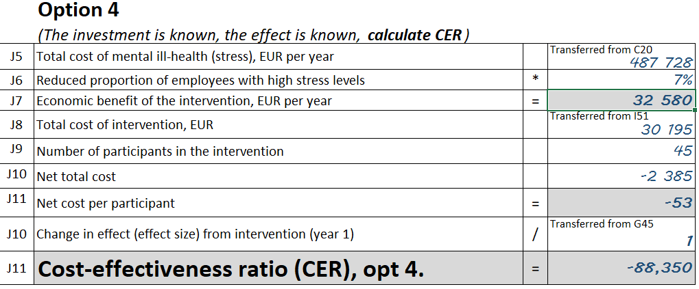
Average cost-effectiveness ratio - ACER
The ACER offers several advantages and practical qualities.
  No comparators needed
  Conveys an intuitive meaning (i.e., cost spent per year)
  Cost-effectiveness threshold not required
  Decision rule based on a fixed budget

Slide 10
The ACER's practical value
Decision makers and payers may want to see the ACER
This information might be used to strengthen claims for interventions to prevent or address workplace mental health issues.
This results could guide decisions of occupational health services providers and employers (management team, managers, HR) in the implementation of a work and health intervention

Slide 11



